Slide 1

Lexicography and spoken German
Dolores Batinić
Institute for the German Language, Mannheim

Slide 2
In a nutshell
We are building a corpus-based lexical resource of spoken German
  LeGeDe: Lexik des gesprochenen Deutsch
Focus:
  Lexicography + interactional linguistics
  Access from semasiological (form➔function) and onomasiological perspective (function➔form)

Slide 3
Motivation
Dictionaries are almost exclusivelly based on written language
For many words, the meaning cannot be analysed properly without spoken language recordings
  Acquiring meaning in interaction: ja, nein, doch, wow...
Notes:
There is already a corpus of spoken German annotated and large enough to support lexicographic work: FOLK

Slide 4
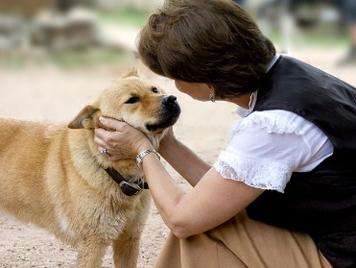
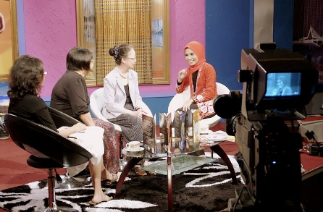

Corpus Material
FOLK:
  Spontaneous interactions in private, institutional and public settings
  Standard German
  Large enough to support lexicographic work (1,95 M tokens)

Slide 5
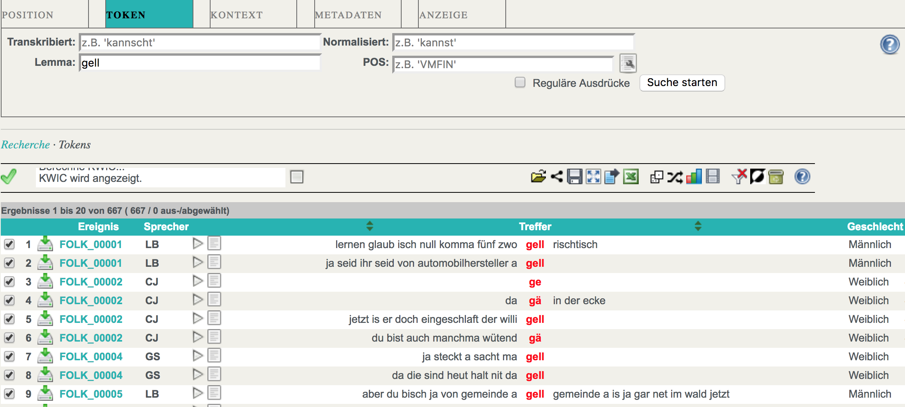
Corpus Material
FOLK:
  Integrated into the Database for Spoken German (DGD):
    Video/audio/transcriptions
    Access to metadata and annotations of various types

Slide 6
Aims
Resource of spoken German:
  Describing new and additional meanings of everyday terms
    Verbs used differently in spoken than in written communication
    Different kinds of interjections, particles and multiword expressions
Notes:
Which lexical means do speaker use to constitute interactional practices?
Ausdruck des (mitfühlenden) Erstaunens, des Entsetzens, der Überraschung, der Entrüstung, der Ungeduld, der Genervtheit, des Mitleids, der Anteilnahme, oft als Rückmeldung auf eine Äußerung eines anderen Gesprächspartners, etc:
(oh/mein) Gott vs. krass vs. was

Slide 7
Data
Current work:
  Determining interactional functions of non-grammatical elements (hesitation particles, receptions signals, etc.)
    (Oh/mein) Gott
      Function: Expression of (empathic) astonishment, horror, surprise, outrage, indignation, impatience, nervousness, compassion, sympathy, often as a response to another person's comments.
Notes:
Which lexical means do speaker use to constitute interactional practices?
Ausdruck des (mitfühlenden) Erstaunens, des Entsetzens, der Überraschung, der Entrüstung, der Ungeduld, der Genervtheit, des Mitleids, der Anteilnahme, oft als Rückmeldung auf eine Äußerung eines anderen Gesprächspartners, etc:
(oh/mein) Gott vs. krass vs. was

Slide 8
Data
Current work:
  Determining interactional functions of non-grammatical elements (hesitation particles, receptions signals, etc.)
    (Oh/mein) Gott
      Function: Expression of (empathic) astonishment, horror, surprise, outrage, indignation, impatience, nervousness, compassion, sympathy, often as a response to another person's comments.
  Determining interactional functions of verbs
    Ex. Verbs of visual perceptions:
      schauen wir mal
        Function: avoiding the answer to a request
      schau mal
        Function: the speaker makes clear that he/she is serious about the clause after schau mal
Notes:
Which lexical means do speaker use to constitute interactional practices?
Ausdruck des (mitfühlenden) Erstaunens, des Entsetzens, der Überraschung, der Entrüstung, der Ungeduld, der Genervtheit, des Mitleids, der Anteilnahme, oft als Rückmeldung auf eine Äußerung eines anderen Gesprächspartners, etc:
(oh/mein) Gott vs. krass vs. was

Slide 9
Data
Current work:
  Determining interactional functions of non-grammatical elements (hesitation particles, receptions signals, etc.)
    (Oh/mein) Gott
      Function: Expression of (empathic) astonishment, horror, surprise, outrage, indignation, impatience, nervousness, compassion, sympathy, often as a response to another person's comments.
  Determining interactional functions of verbs
    Ex. Verbs of visual perceptions:
      schauen wir mal
        Function: avoiding the answer to a request
      schau mal
        Function: the speaker makes clear that he/she is serious about the clause after schau mal

Slide 10
Challenges
Defining interactional function(s)
  Not yet established category in lexicographic description
  Depends on context and previous conversation, conversation topic, common ground, etc.
  The function can be defined on different levels:
    Expression of speaker‘s attitude;
    Expression of cooperation or disagreement;
    Organisation of a conversation;
    …
Lexicographic description of:
  Interactional sequence
  Prosody

Slide 11
Challenges
Defining interactional function(s)
  Not yet established category in lexicographic description
  Depends on context and previous conversation, conversation topic, common ground, etc.
  The function can be defined on different levels:
    Expression of speaker‘s attitude;
    Expression of cooperation or disagreement;
    Organisation of a conversation;
    …
Lexicographic description of:
  Interactional sequence
  Prosody

Slide 12
Challenges
Lexicographic description of frequency information
  Frequent in the corpus vs. perceived as frequent
Lexicographic description of meta-information
  Gender-, group-, age-specific
Connecting the dictionary and the corpus
  Audio/video/transcript

Slide 13
Objectives at LEXMC
What I hope to learn/do at LEXMC:
  Model lexicographic entries for spoken language data
  Experiment with the possibilities of the digital lexicography
  Learn about standards for semasiologic and onomasiologic data description

Slide 14
Time’s Up!
About me:
  Dolores Batinić
  Institute for the German Language, Mannheim
  Background in Slavonic Languages and Computational Linguistics

